Slide 1
Integrated Coastal Zone Management
Unit 6: Objective tree analysis

Slide 2
Introduction
Unit content
Threats and objectives
Objective trees and their use
Comparing different stakeholders’ objective trees
Obtaining consensus on stakeholder objectives
Learning outcomes
Upon completion of this unit, students will be able to
Explore the link between threats and objectives
Justify the selection of management objectives
Understand how an objective tree is constructed
Combine objective trees from different stakeholders

Slide 3
Threats and objectives
A threat can be reversed to become an objective
fishing productivity is low’ BECOMES ‘fishing productivity is increased’
tourism is focused in towns’ BECOMES ‘tourism is not focused in any one place’

Slide 4
Threats and objectives
A threat can be reversed to become an objective
fishing productivity is low’ BECOMES ‘fishing productivity is increased’
tourism is focused in towns’ BECOMES ‘tourism is not focused in any one place’
Using the local threats from unit 5, derive a list of objectives
How can we use this list for management? Are the objectives
Realistic?
Representative?
Appropriate?

Slide 5
Threats and objectives
A threat can be reversed to become an objective
fishing productivity is low’ BECOMES ‘fishing productivity is increased’
tourism is focused in towns’ BECOMES ‘tourism is not focused in any one place’
Using the local threats from unit 5, derive a list of objectives
How can we use this list for management? Are the objectives
Realistic?
Representative?
Appropriate?
Some stakeholders will always be disappointed
Not all objectives will be achieved
Managing stakeholder objections is central to ICZM

Slide 6
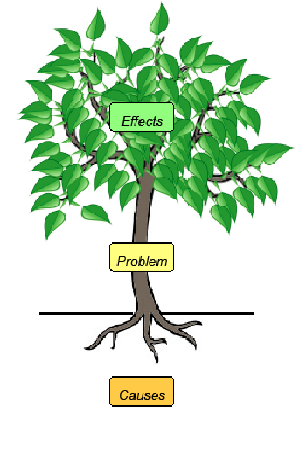
Objective trees
A method to manage environmental objectives
The outcomes (or effects) of achieving the objective are the leaves and branches of the tree.
OUTCOMES
OBJECTIVE
The objective is the trunk of the tree.
MEANS
The means of achieving the objective are the roots of the tree.

Slide 7
Objective trees
A method to manage environmental objectives: increasing fish abundance
OUTCOMES
INCREASING FISH ABUNDANCE
MEANS
How do we increase fish abundance? What needs to be done?

Slide 8
Objective trees
A method to manage environmental objectives: increasing fish abundance
OUTCOMES
INCREASING FISH ABUNDANCE
MEANS
Restricting number of fishers
Restricting number of vessels
Regulating fishing activity
Regulating fishing gear
Closed seasons for fishing
Banning destructive fishing
Establishing marine protected areas
MEANS

Slide 9
Objective trees
A method to manage environmental objectives: increasing fish abundance
What are the (measurable) effects of increased fish abundance?
OUTCOMES
INCREASING FISH ABUNDANCE
MEANS

Slide 10
Objective trees
A method to manage environmental objectives: increasing fish abundance
OUTCOMES
Improved stability in fishers’ income
Greater ability to invest in fishing equipment
Better health and living conditions within fishing communities
Less conflict between fishermen
Less migration out of fishing villages
Greater ecosystem health and resilience
Increased tourism potential
OUTCOMES
INCREASING FISH ABUNDANCE
MEANS

Slide 11
Objective trees
A method to manage environmental objectives: increasing fish abundance
OUTCOMES
Improved stability in fishers’ income
Greater ability to invest in fishing equipment
Better health and living conditions within fishing communities
Less conflict between fishermen
Less migration out of fishing villages
Greater ecosystem health and resilience
Increased tourism potential
OUTCOMES
Which should be the priority?
Why?
INCREASING FISH ABUNDANCE
MEANS
Restricting number of fishers
Restricting number of vessels
Regulating fishing activity
Regulating fishing gear
Closed seasons for fishing
Banning destructive fishing
Establishing marine protected areas
MEANS
Which should be the priority?
Why?

Slide 12
Comparing objective trees
Small group task
You are a) a tourist operator
b) an oil palm plantation owner
c) a marine conservation NGO
d) an urban developer
1) Define your primary (most important) objective
2) Construct an objective tree
Identify all possible means to achieve the objective
Identify all likely outcomes as a result of achieving the objective

Slide 13
Comparing objective trees
Discussion:
To what extent are the objective trees similar?
Where do they differ?
Are all objectives equally measurable?
Are they all equally achievable?

Slide 14
Comparing objective trees
Discussion:
To what extent are the objective trees similar?
Where do they differ?
Are all objectives equally measurable?
Are they all equally achievable?
Coastal managers have to
cope with differing expectations
attempt to reach consensus
manage conflict

